Slide 1



REVIEWS PLATFORM

Slide 2

[--The first Algerian social network
that host reviews and offer valuable feedback for brand owners--]

Slide 3



PROBLEM
xxxxxxxxxxxxxxxxxxxxxxxxxxxxxxxxxxxxxxxxxxxxxxxxxxxxxxxxxxxxxxxxxxxxxxxxxxxxxxxxxxxxxxxxxxxxxxxxxxxxxxxxxxxxxxxxxxxxxxxxxxx
xxxxxxxxxxxxxxxxxxxxxxxxxxxxxxxxxxxxxxxxxxxxxxxxx
xxxxxxxxxxxxxxxxxxxxxxxxxxxxxxxxxxxxxxxxxxxxxxxxxxxxxx

Slide 4

WHY
NOW?
Evolution of your product Category
xxxxxxxxxxxxxxxxxxxxxxxxxxxxxxxxxxxxxxxxxxxxxxxxxxxxxxxxxxxxxxxxxxxxxxxxxxxxxxxxxxxxxxxxxxxxxxxxxxxxxxxxxxxxxxxxxxxxxxxxxxxxxxxxxxxxxxxx.
xxxxxxxxxxxxxxxxxxxxxxxxxxxxxxxxxxxxxxxxxxxxx
33.1 %
Consumers feedback is being
Neglected and wasted for most of the times.

Slide 5




SOLUTION
xxxxxxxxxxxxxxxxxxxxxxxxxxxxxxxxxxxxxxxxxxxxxxxxxxxxxxxxxxxxxxxxxxxxxxxxxxxxxxxxxxxxxxxxxxxxxxxxxxxxxxxxxxxxxxxx
Use Case 1
xxxxxxxxxxxxxxxxxxxxxxxxxxxxxxxxxxxxxxxxxxxx
Value Proposition
xxxxxxxxxxxxxxxxxxxxxxxxxxxxxxxxxxxxxxxxxxxxxxxxxxxxxxxxxx
Use Case 1
xxxxxxxxxxxxxxxxxxxxxxxxxxxxxxxxxxxxxxxxxxxxxx.

Slide 6
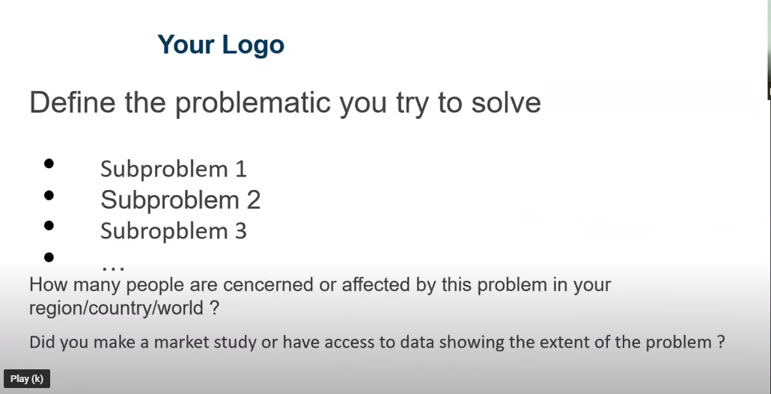

Slide 7
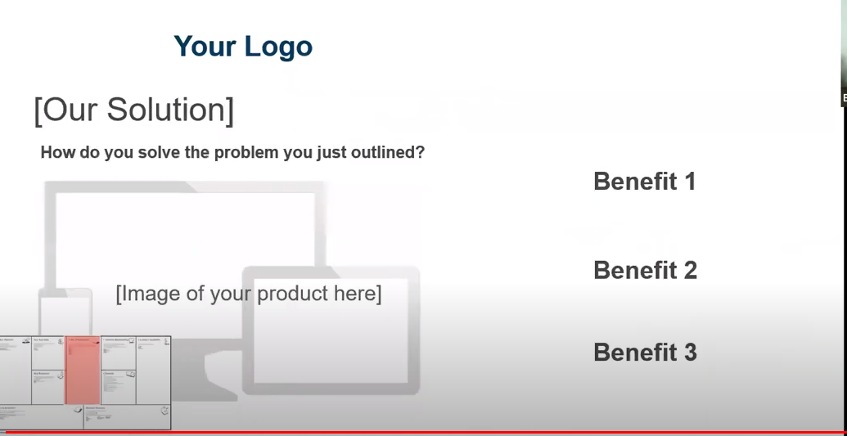

Slide 8
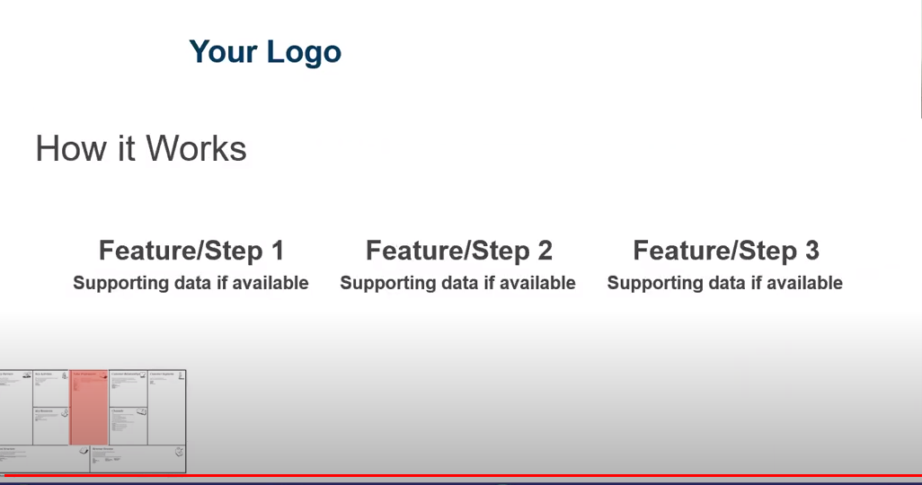

Slide 9
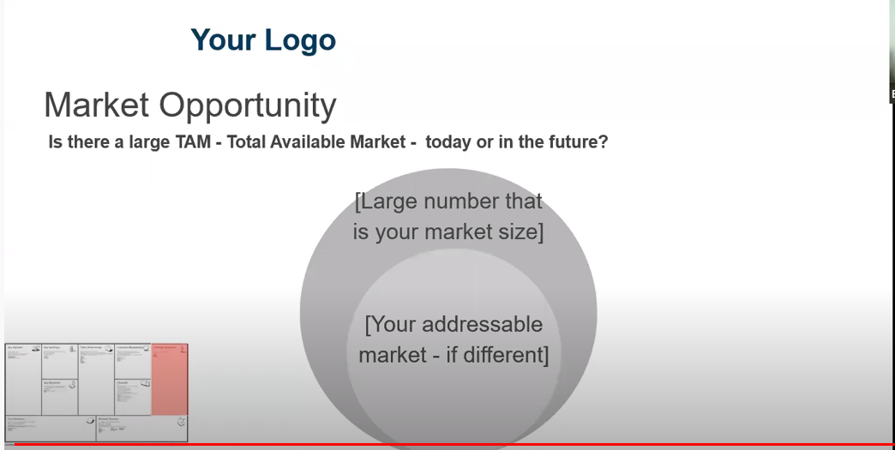

Slide 10
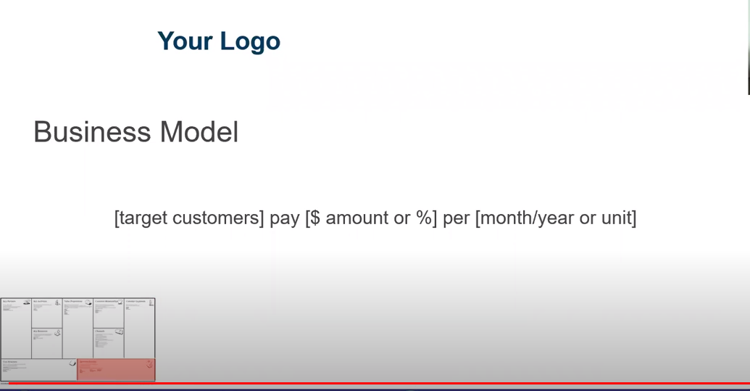

Slide 11
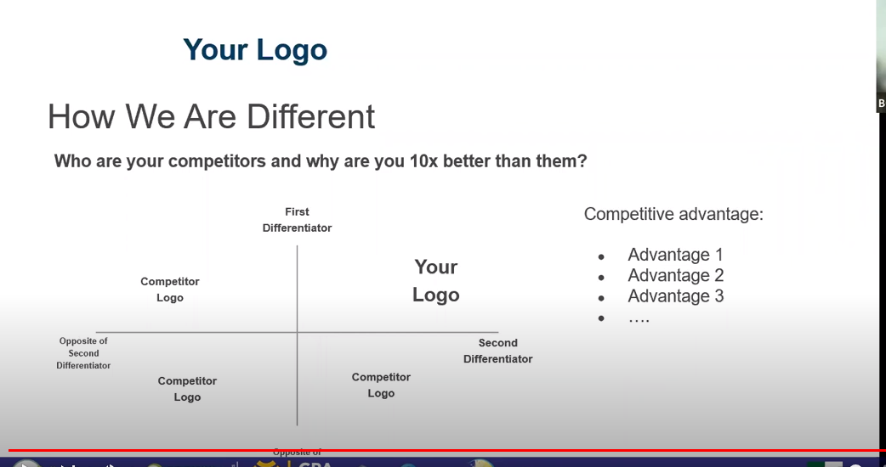

Slide 12
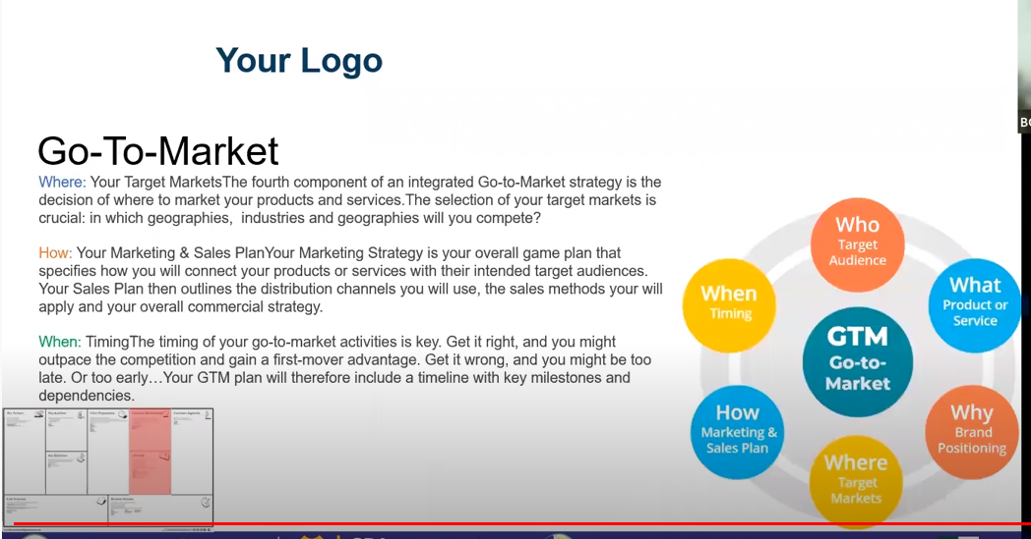

Slide 13
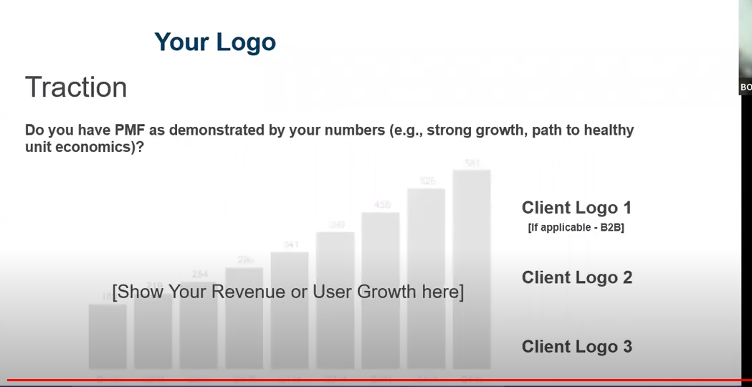

Slide 14
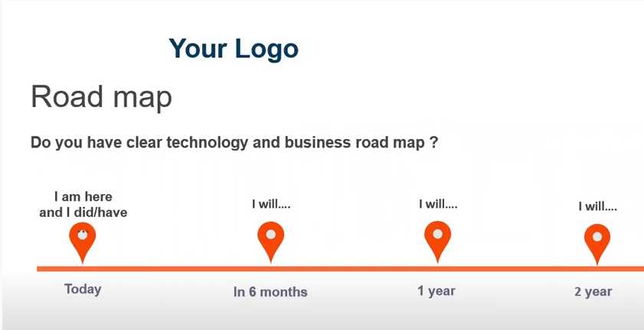

Slide 15
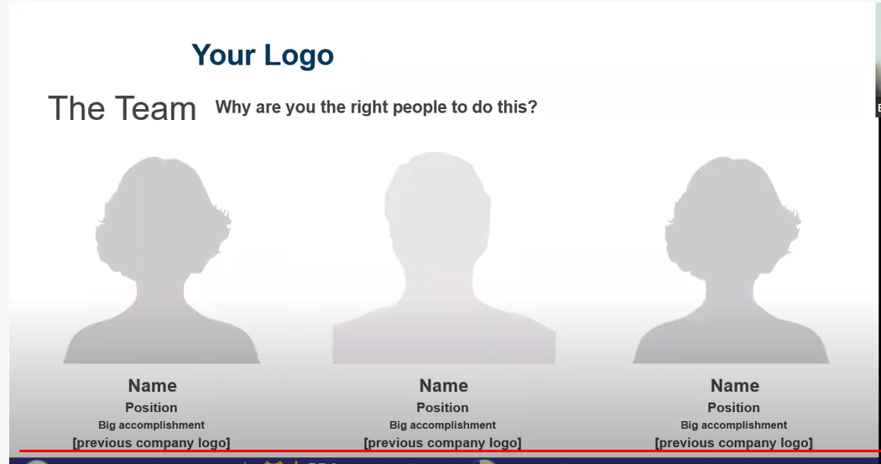

Slide 16
https://slidemodel.com/templates/sequoia-capital-powerpoint-pitch-deck/

